Slide 1
Simulating a Hosts Files Attack
Project 5-3, pp. 227

Slide 2
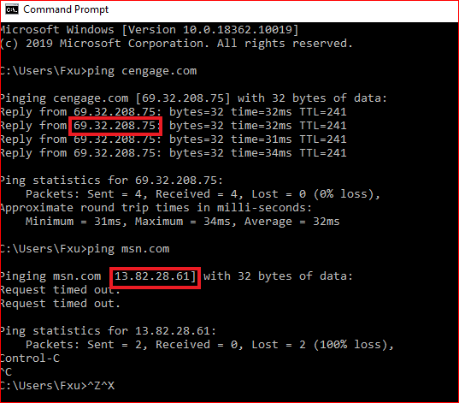

Slide 3
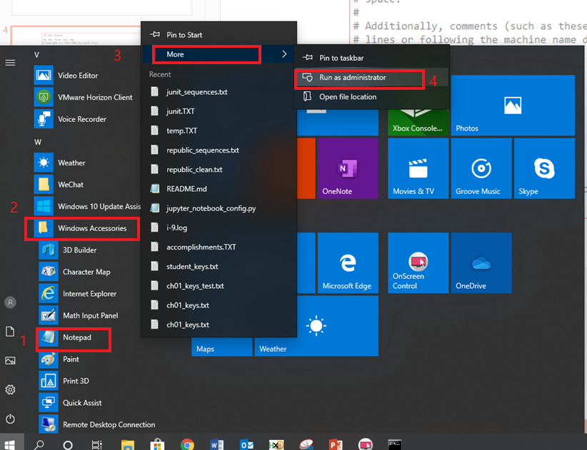

Slide 4
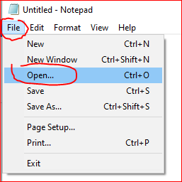

Slide 5
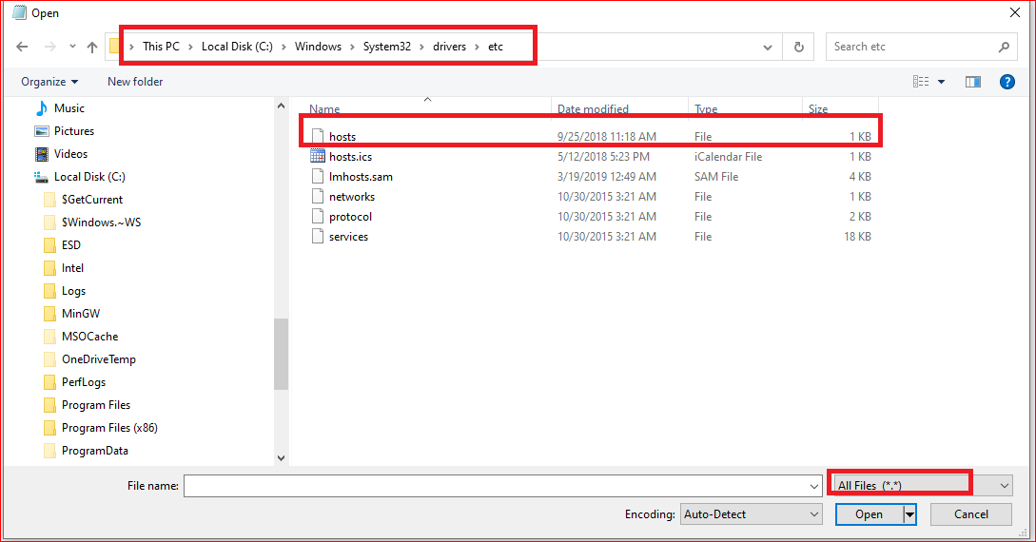

Slide 6
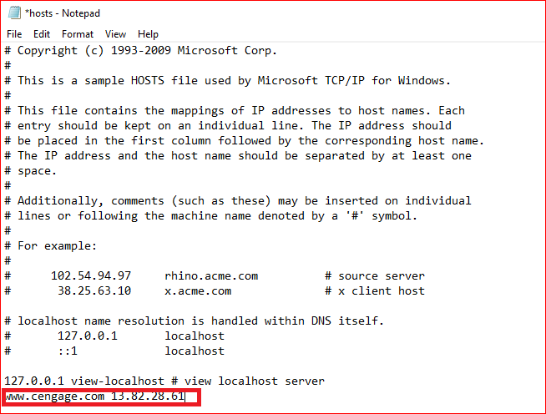

Slide 7
Last step
Restart your PC
Go to cengage.com to obverse the results.
You may want to delete the entry after the lab

